Slide 1
Comp-Bio Group
‘Admin Interestingness’

Slide 2
Handout is on the following page:
I intend for the following diagram to be printed as a handout …

Slide 3
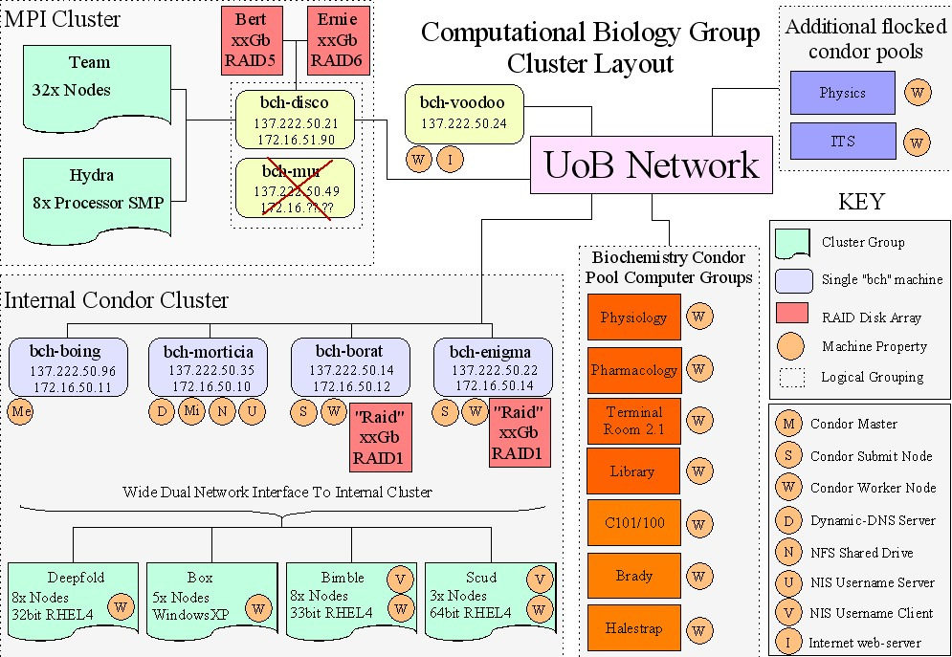

Slide 4
Hardware Layout
The Comp-Bio network is now separated into three conceptual units:
  MPI Cluster
    The TEAM and Hydra
    Facilitates jobs where fast networking is critical
  Condor Cluster
    Small Serial Job Distribution System across a variety of different calibre hardware
    Spreads across both the UoB network and the internal pool via some ‘cleaver’ networking tricks.
  Web Server
    Information Distribution (Wiki)
    Source Code server (SVN – SubVersion)
Segregation:
  More secure to separate the MPI and Condor clusters in network space
  There is no reason why you would want an MPI node to “speak to” a Condor Node
  All important nodes (disco, borat, enigma, morticia, boing) are all on the UoB network and can therefore directly communicate.

Slide 5
Web Server

Slide 6
bch-voodoo
Apache2 web server (WinXP)
  Wiki
    https://bch-voodoo.bch.bris.ac.uk/DOKUWiki/
  SVN (subversion) source code server
    https://bch-voodoo.bch.bris.ac.uk/svn/???/
    Where ‘???’ Is the name of the repository
  Boa Doxygen Documention
    Automatically generated nightly from the source code itself via a script

Slide 7
MPI Cluster

Slide 8
MPI Cluster
Centred around Bch-disco:
  Conceptually supersedes bch-mur
  Physically replaces bch-mur because we are out of network sockets ;-)
  Houses the ‘interface’ to:
    /home – Small HDD to keep bch-disco going in the face of RAID failures
    /Bert – 874Gb RAID5 “Backup Space”
    /Ernie – 269Gb RAID5 “Scratch space”
    In theory RAID5 can tolerate 1 disk failure and should mark a disk as ‘bad’ if errors occur. If a disk is down the array is marked ‘degraded’ and needs rebuilding.
  Provide the network interface to:
    The Team
    Hydra

Slide 9
Condor Cluster

Slide 10
Condor Cluster
Condor is ‘ideal’ (read ‘way better than .csh scripts’) for the distribution of ‘small serial jobs’
We use but a small fraction of condors features – these features are well established, well tested and well documented.
Pros:
  Submission system: Single, standard, unified, easy-to-use
  Job Monitoring
  Fault Tolerance (if a machine reboots, your job is run elsewhere
Cons:
  Jobs must by definition be relatively short and small (~1hour / a few MB of data).
    This is fine for most of what we do: i.e. output is a single PDB and compute is intensive.
    The programs myself and mike write are highly parallelisable in small segments **due** to condors limitations.
  Jobs that require large data sets can be run over NFS as the internal pool has a shared file system
    but the condor network is far from speedy due to a couple of single shared 100mbit network cable “bottle-necks”.
    NFS jobs are of course limited to the internal cluster.
  There is no ‘easy’ way to have jobs that require SMP.
    The newer version of condor **can** do this
    I have no idea how it works – it is not set-up on our system
  There are some condor-niggles
    nothing major and still better than .csh
    Info / walkrounds are posted on the wiki (as always)

Slide 11
Condor Cluster Consists of:
(As it stands 02.10.06)
Central 4 manager nodes
  Morticia (Internal Pool Master and general controller)
  Boing (UoB Pool Master)
  Borat (Dedicated submit Node)
  Enigma (Dedicated submit Node)
Flocked Pools
  The UoB Pool
    Cappi
      Library
      Pharmacology
      Physiology (soon?!?)
      Southwell St. (Vetinary)
    Kearsy
      Biochem teaching labs
    C101
      Booth, Jones, Burston
    C100
      Collinson
    Yellow Empire
      Savery, Gaston
  Physics (Cooperative)
  IS (Bureaucratic fools)
  Chemistry (They are being reluctant)
  Engineering (They are being reluctant)
  The Internal Pool (Various Internal Node-Sets)
    Windows
      Box
    RHEL4 64bit AMD
      Scud
    RHEL4 32bit
      Bimble
      Deepfold
      Shaft (the machines in D35)

Slide 12
Bch-boing
Dedicated condor master for the biochem group pool
Now running RHEL4
‘Flocks’ to: (meaning you can run jobs on another pool)
  bch-morticia (internal pool)
  Physics
  (IS in the future??)
Runs a webserver to:
  Administer config scripts to the biochem pool. A service runs in the department that contacts boing for the latest condor config file, ensuring the pool policy remains up-to-date.
  Show pool status: http://bch-boing.bch.bris.ac.uk/condor_monitor/boing/condorview/

Slide 13
Bch-morticia
Dedicated condor master for the internal non-MPI cluster room
Runs the following services:
  Condor Master
  NIS – Usernames are mapped from morticia across the whole internal cluster – the home directory is also shared.
  NFS
    /nfs_mount
    /shared_mount
    /home (shared across the cluster)
  Dynamic DNS (DNS (named = bind v8) and DHCP (dhcpd))
    All the condor machines use morticia as their DNS server for both the inter and intranets
  Redhat kick-start server
    Allows automatic rebuilding of cluster nodes in <15 mins
  NTP – keep the current time synchronised across the cluster

Slide 14
Bch-enigma and bch-borat
Dedicated condor submit nodes
  As these nodes have both internal and external IP addresses (they have 2 network cards) they can submit to both pools.
  Both point to the bch-boing master
  Flocking allows them to also negotiate with bch-morticia. Following negotiation they can communicate with the nodes in the internal pool.
  Both have fast RAID devices
    Borat uses software RAID 1 over multiple SCSI disks
    Enigma uses hardware raid over two IDE disks
    Mike has found it useful to use an additional RAM drive when repetitively submitting the same files to condor.

Slide 15
Future of Admin
Admin responsibility shift:
  Dodd: Disco, Hydra
  Tom: Team, bch-voodoo
  Crispy: Condor Pool & Condor Servers
We will try to make the switch in the coming weeks before Xmas …

Slide 16
You want more?
Things for discussion …
Does anyone what to know anything else?
  Condor submission policy
  Password Policy? Is it good to have them the way we do or should there be more specifics ?
  UPS for the server machines

